Slide 1
Index Standardization - Simulation
Grant Adams

Slide 2
Simulate Index Standardization

Slide 3
Steps
Simulate a population through time
Create a habitat map
Create a habitat suitability function
Distribute the population across space
Sample the population
Fit a GLM
Create index

Slide 4
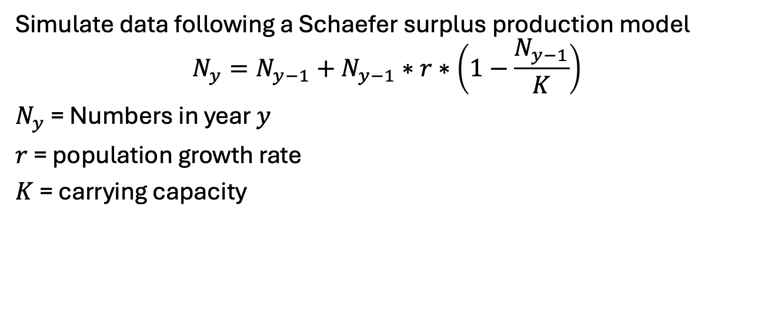
Step 1: Simulate a population
Simulate data following a Schaefer surplus production model
$$N_{y}=N_{y−1}+N_{y−1}∗r∗\left(1−\frac{N_{y−1}}{K}\right)$$
$N_{y}$ = Numbers in year $y$
$r$ = population growth rate
$K$ = carrying capacity

Slide 5
set.seed(487) K = 1e6 # Carrying capacity R = 0.2 # Growth Rate N0 = 5e5 nyrs = 50 Rer <- rnorm(nyrs, 0, 0.3) # AR1 error # - Schaefer model N <- N0 Ryr <- R for(yr in 2:nyrs){ Ryr[yr] = R + 0.5 * Rer[yr-1] + Rer[yr] N[yr] <- (N[yr-1] + Ryr[yr-1] * N[yr-1] * (1 - N[yr-1]/K)) * exp(rnorm(1, 0, 0.05)) }

Slide 6
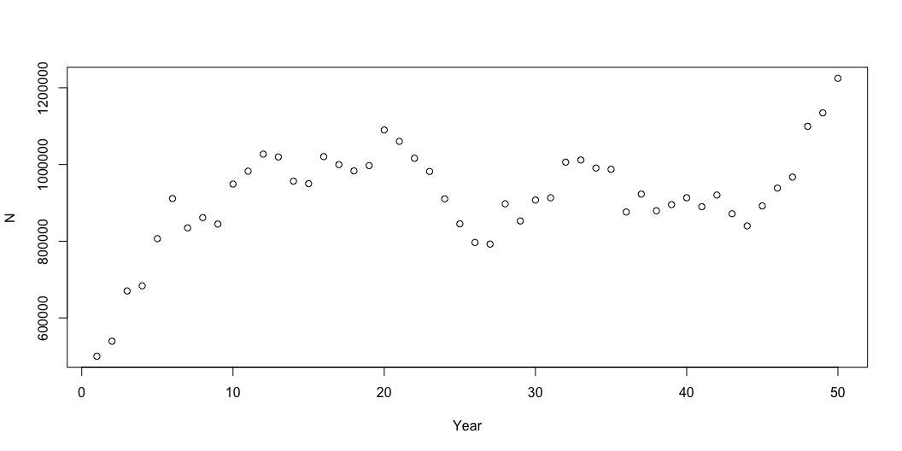
# Plot total numbers plot(x = 1:nyrs, y = N, xlab = "Year", ylab = "N")

Slide 7
Step 2: Habitat map
Abundance is a function of depth
## Get bathymetry chile_bathy <- getNOAA.bathy(lon1 = -85, lon2 = -65, lat1 = -10, lat2 = -60, resolution = 10) chile_bathy <- as.raster(chile_bathy) chile_bathy[chile_bathy > 0 ] <- NA

Slide 8
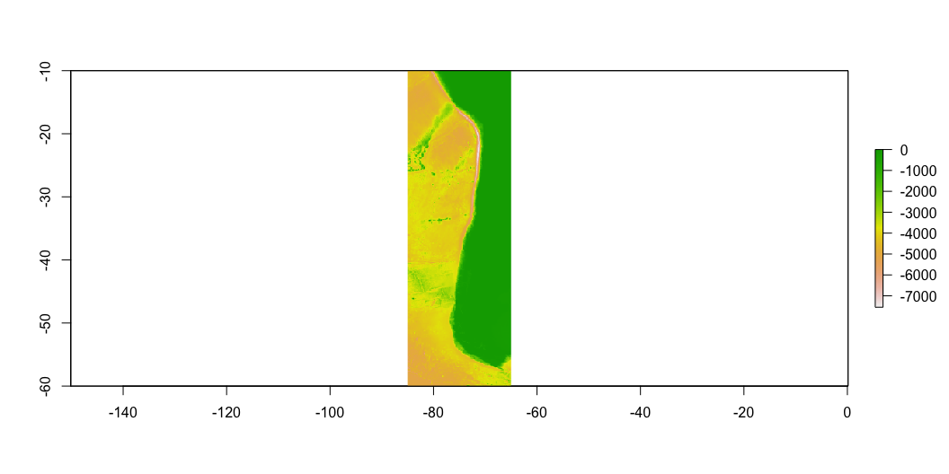

Slide 9
## Convert to grid polygony <- st_make_grid(chile_bathy, square = T, what = "polygons", cellsize = 1) %>% st_sf() # Mean depth in grid e <- raster::extract(chile_bathy, polygony, buffer = .5, # specify a .5 degree radius fun = mean, # extract the MEAN value from each plot cellnumbers = TRUE, sp = TRUE) # Store values in grid polygony <- polygony %>% dplyr::mutate( depth = e$layer, # Depth grid_id = 1:length(polygony$geometry), # Grid ID grid_id = ifelse(depth > -10, NA, grid_id) )

Slide 10
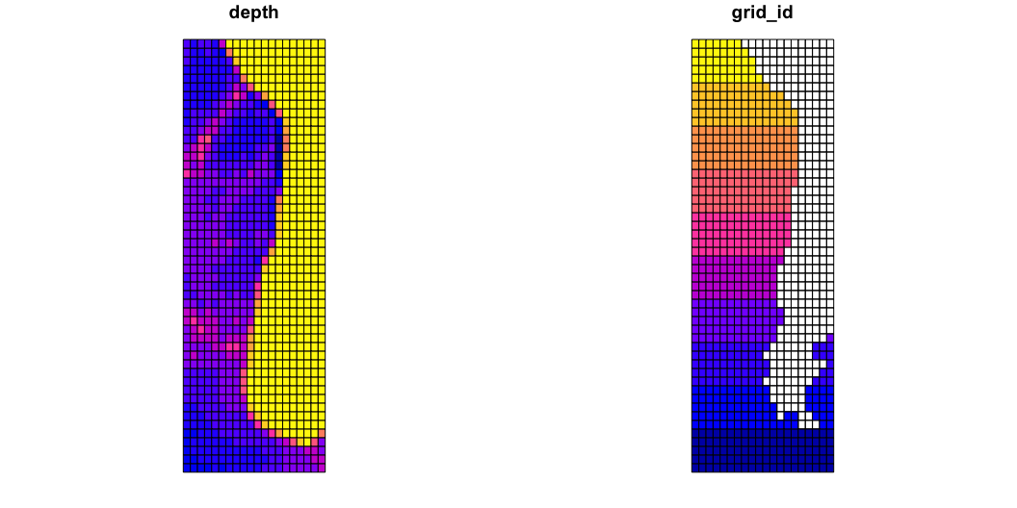

Slide 11
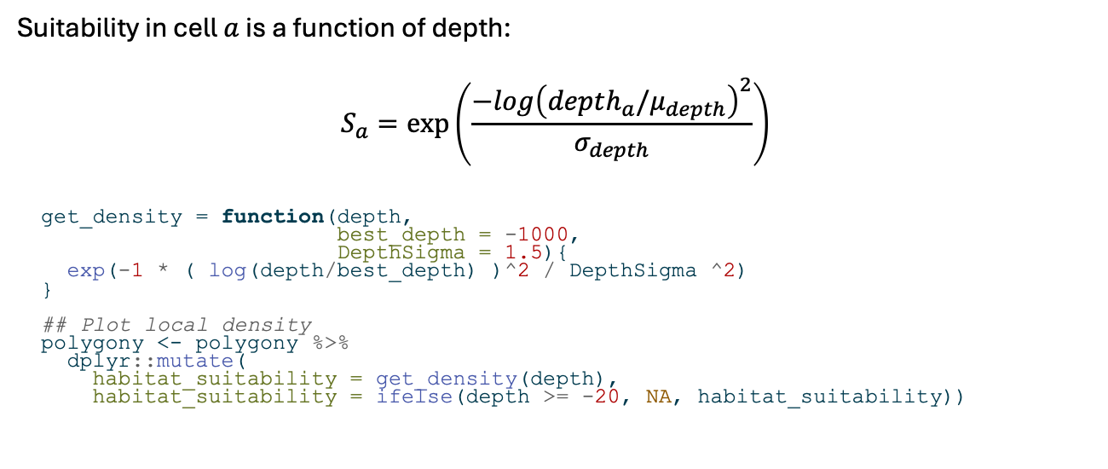
Step 3: Habitat suitability
Suitability in cell $a$ is a function of depth:
$$S_{a}=exp\left(\frac{−log{\left(depth_{a}/μ_{depth}\right)}^{2}}{σ_{depth}}\right)$$
get_density = function(depth, best_depth = -1000, DepthSigma = 1.5){ exp(-1 * ( log(depth/best_depth) )^2 / DepthSigma ^2) } ## Plot local density polygony <- polygony %>% dplyr::mutate( habitat_suitability = get_density(depth), habitat_suitability = ifelse(depth >= -20, NA, habitat_suitability))

Slide 12
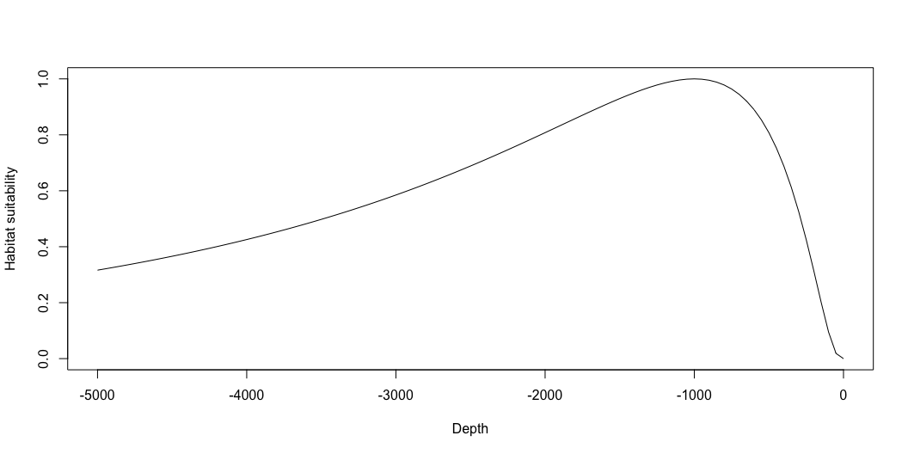

Slide 13
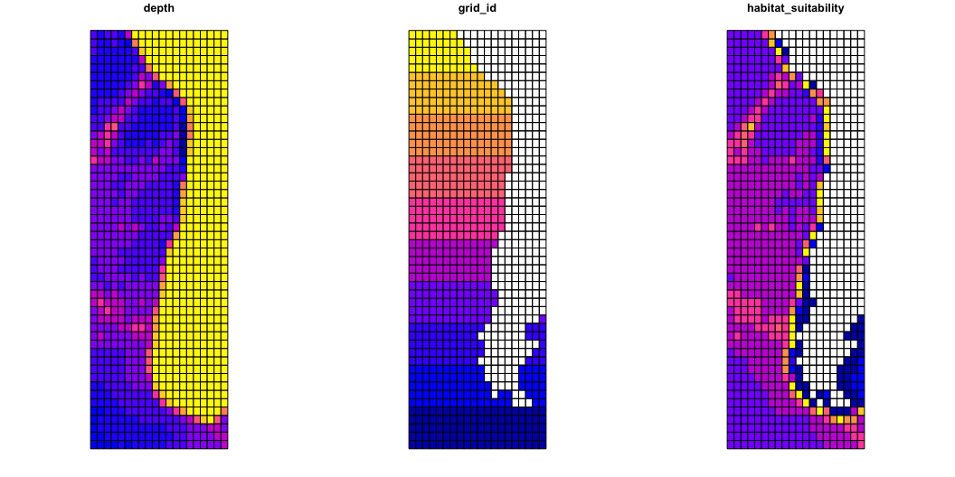

Slide 14
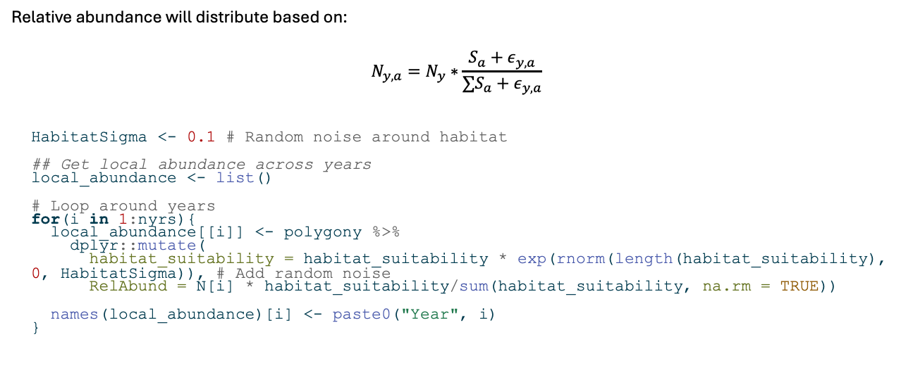
Step 4: Distribute the population
Relative abundance will distribute based on:
$$N_{y,a}=N_{y}∗\frac{S_{a}+ε_{y,a}}{∑S_{a}+ε_{y,a}}$$
HabitatSigma <- 0.1 # Random noise around habitat ## Get local abundance across years local_abundance <- list() # Loop around years for(i in 1:nyrs){ local_abundance[[i]] <- polygony %>% dplyr::mutate( habitat_suitability = habitat_suitability * exp(rnorm(length(habitat_suitability), 0, HabitatSigma)), # Add random noise RelAbund = N[i] * habitat_suitability/sum(habitat_suitability, na.rm = TRUE)) names(local_abundance)[i] <- paste0("Year", i) }

Slide 15
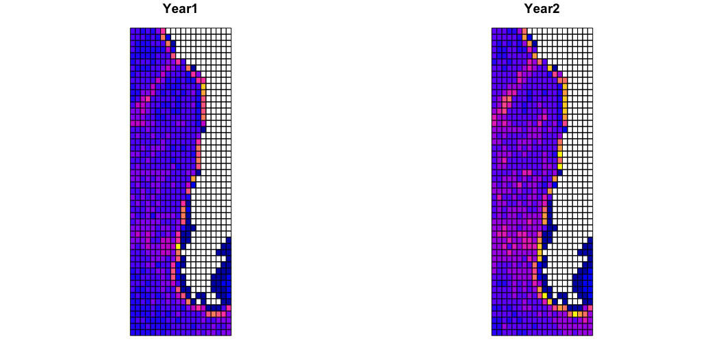

Slide 16

Step 5: Sample the population
Annual survey with 50 haul locations $h$
Assume $q=0.1$
$$I_{y,h}∼\text{Binom}\left(N_{y,a},q\right)$$

Slide 17
## Apply annual survey ---- n_hauls <- 50 q <- 0.1 cells <- sample(local_abundance[[1]]$grid_id[which(!is.na(local_abundance[[1]]$grid_id))], n_hauls) # Where to sample

Slide 18
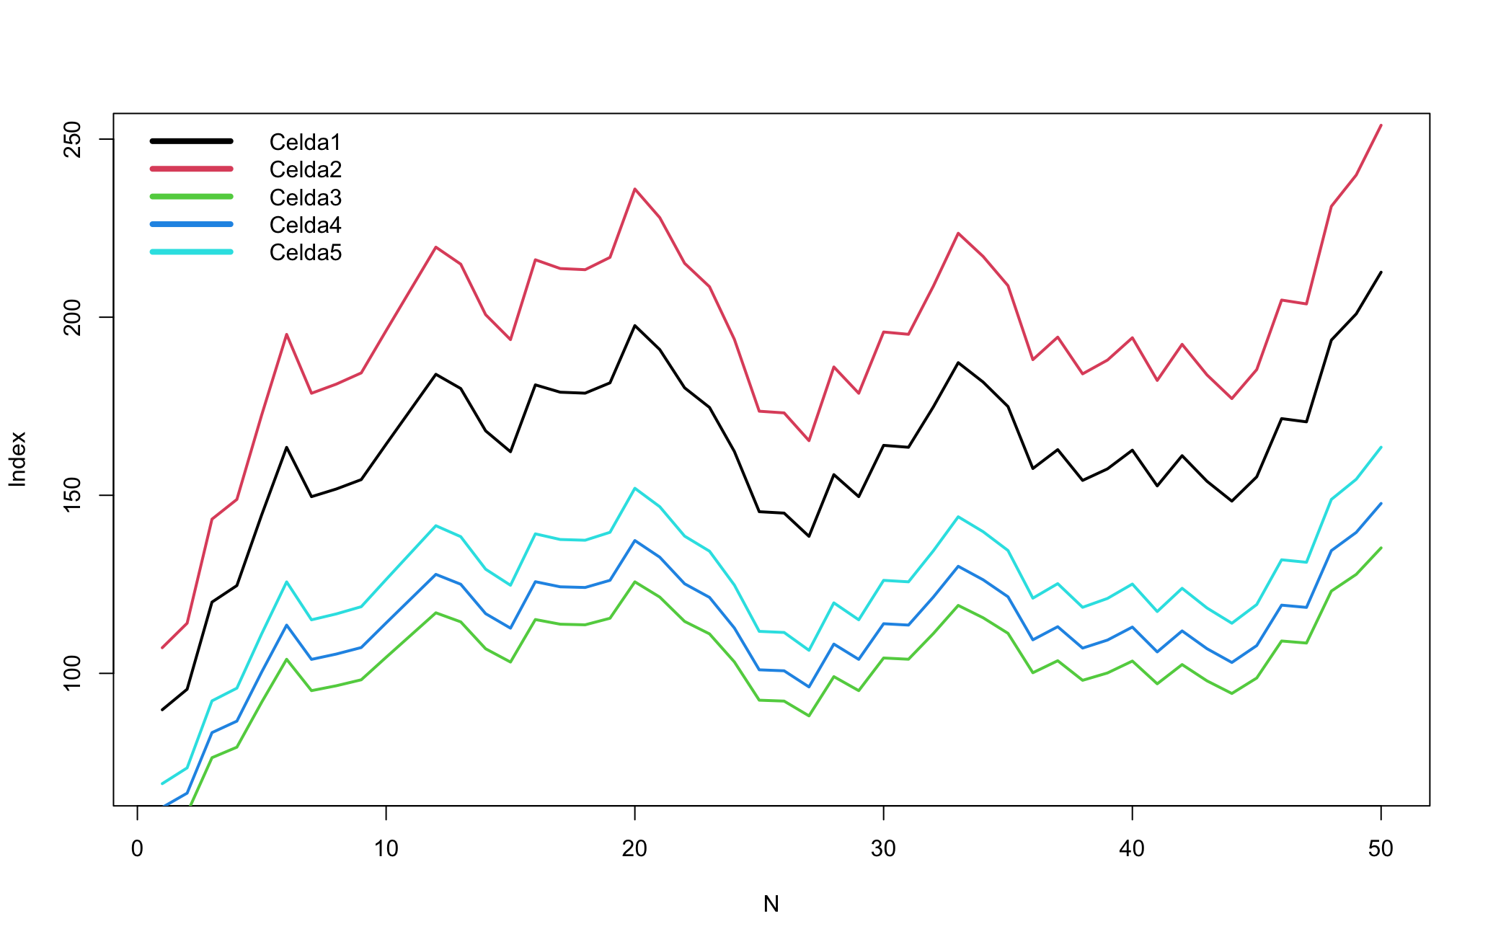
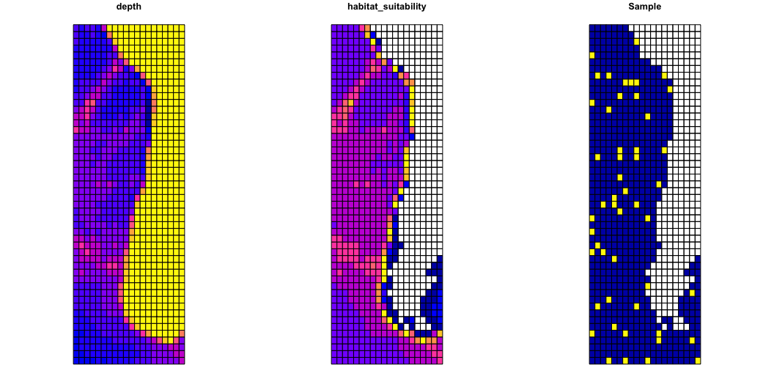

Slide 19
# Sample
haul_data <- data.frame(Years = NULL, Haul = NULL, CPUE = NULL) for(i in 1:nyrs){ for(j in 1:n_hauls){ haul_tmp <- data.frame(Year = i, Haul = j, Cell = j, Depth = local_abundance[[i]]$depth[which(local_abundance[[i]]$grid_id == cells[j])], CPUE = rbinom(n = 1, size = round(local_abundance[[i]]$RelAbund[which(local_abundance[[i]]$grid_id == cells[j])]), prob = q )) haul_data <- rbind(haul_data, haul_tmp) } }

Slide 20
Step 6: Fit CPUE model
Model base:
glm(CPUE ~ as.factor(Year), data = haul_data)
Normal
Poisson
Depth?
Que mas?

Slide 21
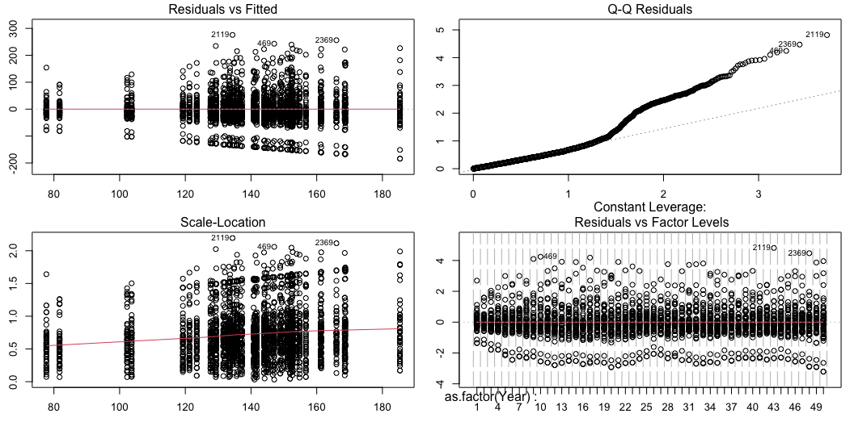
Model 1 (Normal)
mod1 = glm(CPUE ~ as.factor(Year), data = haul_data) par(mfrow = c(2, 2), mar = c(3, 2.5, 1.5, 1)) plot(mod1)

Slide 22
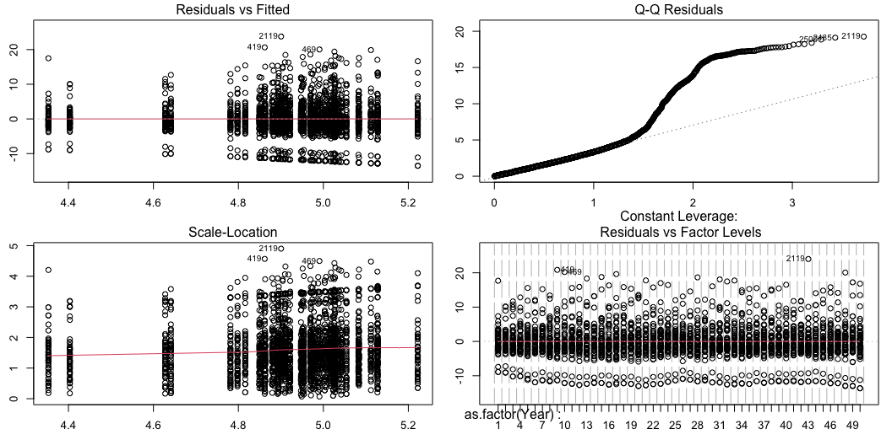
Model 2 (Poisson)
mod2 = glm(CPUE ~ as.factor(Year), family = poisson(link = "log"), data = haul_data) par(mfrow = c(2, 2), mar = c(3, 2.5, 1.5, 1)) plot(mod2)

Slide 23
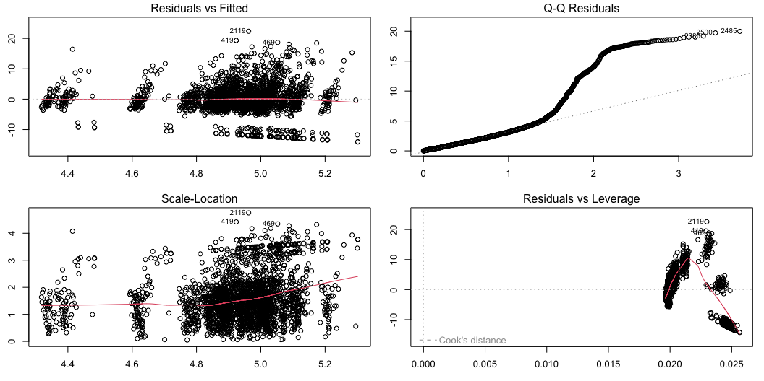
Model 3 (Poisson w/ depth)
mod3 = glm(CPUE ~ as.factor(Year) + Depth + Depth^2, family = poisson(link = "log"), data = haul_data) par(mfrow = c(2, 2), mar = c(3, 2.5, 1.5, 1)) plot(mod3)

Slide 24
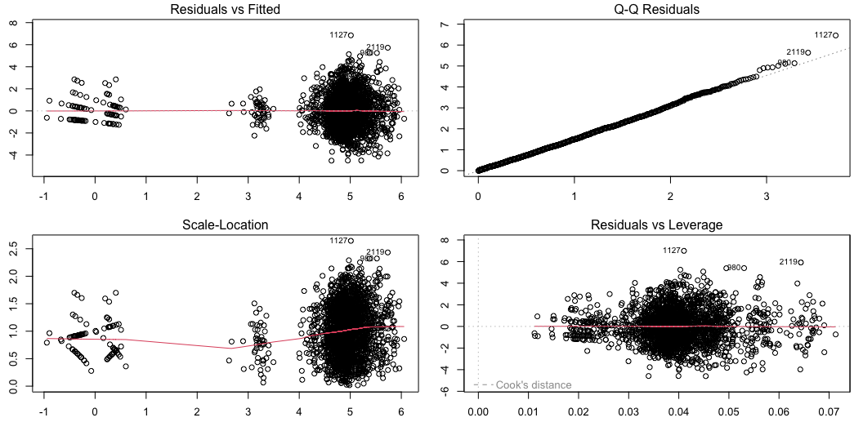
Model 4 (Poisson w/ location)
mod4 = glm(CPUE ~ as.factor(Year) + as.factor(Cell), family = poisson(link = "log"), data = haul_data) par(mfrow = c(2, 2), mar = c(3, 2.5, 1.5, 1)) plot(mod4)

Slide 25
Step 7: Create index
# Dummy data pred_data <- data.frame(Year = 1:nyrs, Cell = 1) pred <- predict(mod4, newdata = pred_data, type = "response", se = TRUE) # Mean pred_data$Index <- pred$fit # 95% CI pred_data$Lower <- pred$fit - pred$se.fit * 1.96 pred_data$Upper <- pred$fit + pred$se.fit * 1.96

Slide 26
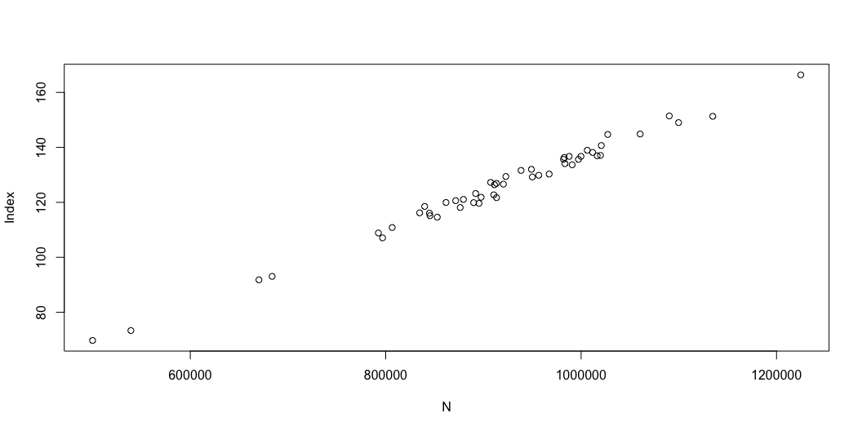
How well did we do?

